Slide 1
Exploring Mental Health and Mortality Trends in the U.S.
BY: Hewan Kasie, Paige O’Neil, Naina Sharma, Kaleigh West

Slide 2
What is our project ?
Mental health and cause of death are two critical aspects of public health, with increasing global attention.
Our project uses data to uncover how mental health trends correlate with preventable deaths.
Datasets: Mental Health Dataset (441 KB, 6420 rows x 8 columns) and Causes of Death Dataset (822 KB, 6120 rows x 34 columns).
Data from 1990-2019 worldwide
Expecting to see positive correlations between certain mental health disorders and causes of deaths (ex. Eating disorders → cardiac-related deaths, alcohol substance use disorder → liver failure?)
Transform
Load
Extract
Download datasets from Kaggle
Clean up column names
Convert prevalence rates to number of cases
Filter datasets to include only the US
Combine datasets
Load new dataset to MongoDB/Google Cloud
Notes:
Our project investigates the relationship between mental health trends and preventable deaths in the U.S. With increasing awareness around mental health, we wanted to examine how these trends are reflected in data and how they relate to preventable causes of death. We used two datasets: one on mental health disorders and another on causes of death. Both had data for each year between 1990-2019 in every country. By merging these datasets, we aimed to uncover meaningful correlations.
We encountered several challenges during data preparation. For example, column naming differences like 'Country/Territory' and 'Entity' required standardization. Additionally, the original datasets had inconsistent data units, with one reporting absolute numbers of deaths, and the other reporting prevalence rates. To remedy this, we multiplied the values reported as rates by the population of the US that year to get an estimated number of cases, so that we would be comparing two sets of absolute numbers. Overall, we were able to use Python's Pandas library for cleaning and merging, which allowed us to handle large datasets efficiently.
So to summarize our ETL pipeline, we first extracted our data by downloading the CSVs from Kaggle. Then, we transformed these datasets by cleaning up column name inconsistencies, converting prevalence rates to number of cases (for the mental health dataset), filtering to only include the US, and finally combining the datasets by joining on country and year. Finally, we loaded this new dataset to MongoDB and Google Cloud.

Slide 3
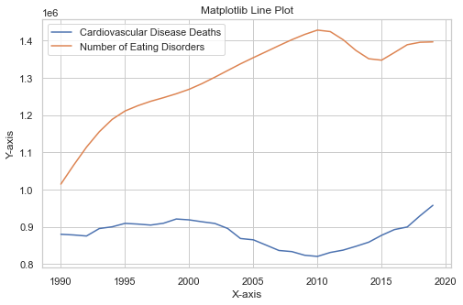
Key Insights
Insights:
Extremely high rate of EDs over time
Drop in ED rate -- could be attributed to more awareness of the disorders
Drop in cardiovascular disease deaths in 2010
Could be related to more efforts public health campaigns and advancements in medicine
Spike in EDs in 2010
Could be related to more social media use or more awareness → better diagnosis

Slide 4
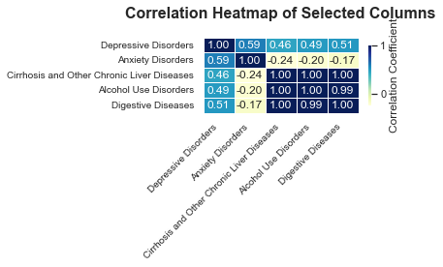
Correlation Analysis
Positive correlations between depressive disorders and health problems relating to alcohol consumption
Negative correlation between anxiety disorders and alcohol use
Strong positive correlation between alcohol use disorders and cirrhosis and other chronic liver diseases
BRAND NAME
Notes:
Our correlation analysis uncovered several important relationships between mental health disorders, alcohol use, and related health outcomes. We found a positive correlation between depressive disorders and health issues linked to alcohol consumption, which may reflect the use of alcohol as a coping mechanism, leading to adverse physical health effects. In contrast, there was a negative correlation between anxiety disorders and alcohol use, possibly due to individuals with anxiety avoiding alcohol because it can exacerbate their symptoms. Additionally, we identified a strong positive correlation between alcohol use disorders and chronic liver diseases, such as cirrhosis, which aligns with established medical findings. These insights highlight the importance of targeted public health interventions for individuals at risk and suggest the need for further research to explore causation, demographic influences, and preventative strategies to address these issues.

Slide 5
Lessons and Future Improvements
Lessons:
Finding correlations and interesting insights from separate and somewhat unrelated datasets
Technical: Proficiency in Pandas, NoSQL, and Google Cloud Storage.
Collaborative: Importance of communication and task delegation.
Future:
Automate ETL pipelines with Airflow.
Use Tableau for interactive visualizations.
Be more selective in process of choosing data
Notes:
This project taught us technical skills, like using Pandas for data manipulation and querying, as well as soft skills like effective communication in collaborative work. Looking ahead, we aim to automate ETL processes using tools like Apache Airflow. This would reduce manual errors and ensure timely data updates.Another improvement is adopting interactive tools like Tableau to create dynamic visualizations, making data exploration more engaging.

